Slide 1
Report: Ipsa the Time Reset Aqua
Charlotte Ting Fung Chan •26.07.2021

Slide 2
Overview
•Client: XX luxury skincare brand
•Competitor brand: Ipsa
•Data: Ipsa The Time Reset Aqua
•Targets:
General understanding of the performance
What kind of platform had the best result?
Which platform had the best result(s)?
Which keywords bring the most significant feedback?
Any other factor(s) may affect the result?

Slide 3
Part 1:
General understanding of the performance

Slide 4
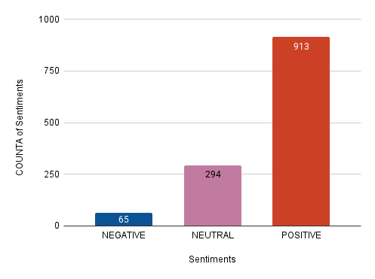
General feedback in 2020
1271 posts came from Japan, 1 post came from Taiwan
71.8% posts (913) were positive
Only 5.1% posts (65) were negative

Slide 5
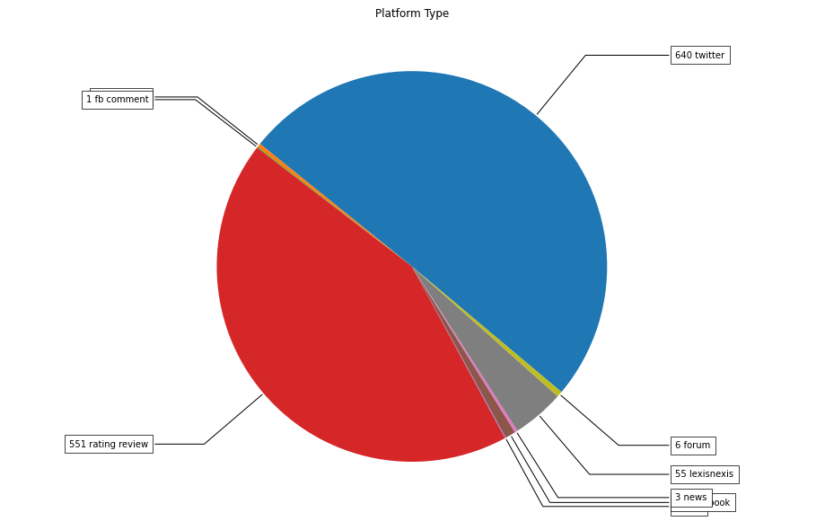
Mentioned times in different platforms:
In 2020, Ipsa the Time Reset Aqua has been mentioned 1272 times in 9 different social platforms.
These 9 different social platforms are:
Twitter (640)
Rating review (551)
Lexisnexis (55)
Facebook (11)
Forum (6)
Instagram (4)
News (3)
Fb comment (1)
Blog (1)

Slide 6
Part 2:
What kind of platform had the best result?

Slide 7
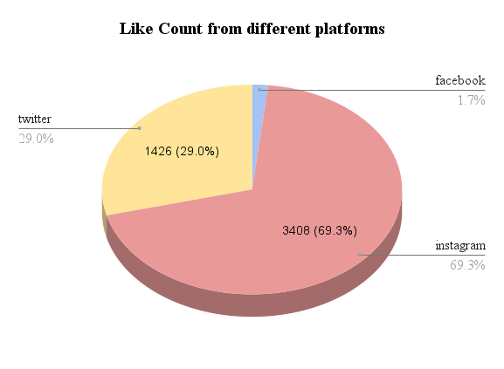
High mentioned times = good performance?
Although Ipsa the Time Reset Aqua had been mentioned a lot in Rating review (551) and Lexisnexis (55), facebook & instagram brought a better performance.
The product had just mentioned 4 times in Instagram. But instagram got the highest numbers of likes in 2020, even more than twitter! It means Instagram brings a much more efficient performance than other platforms.

Slide 8
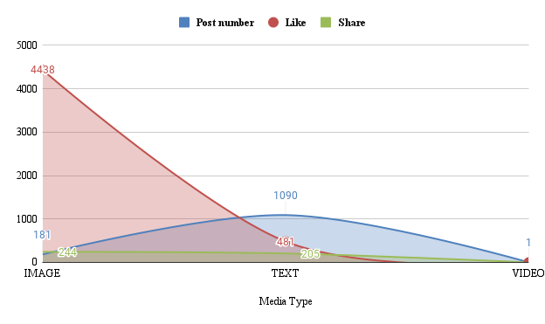
Which media type brings the best impact?
In 2020, there are total 1090 TEXT posts, 181 IMAGE posts and 1 VIDEO posts about the product.
Although the number of IMAGE posts is fewer than TEXT posts (909 difference), the LIKES & SHARE numbers from IMAGE posts are much more than TEXT posts.
The number of LIKES from IMAGE is 4438. It is nearly 10 times of TEXT.
The number of SHARE from IMAGE is 244, also more than TEXT posts.

Slide 9
Part 3:
Which platform had the best result(s)?

Slide 10
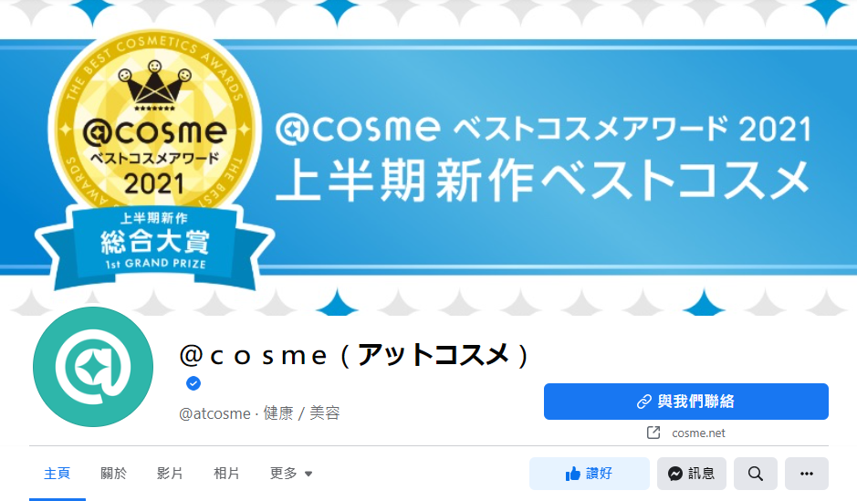
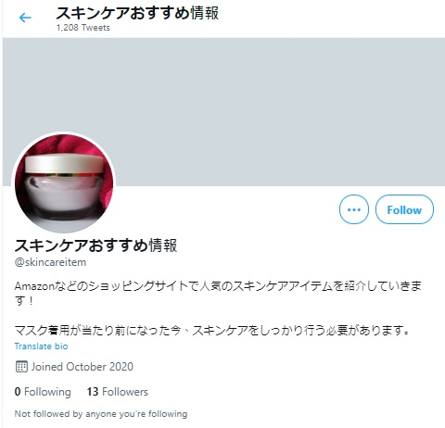
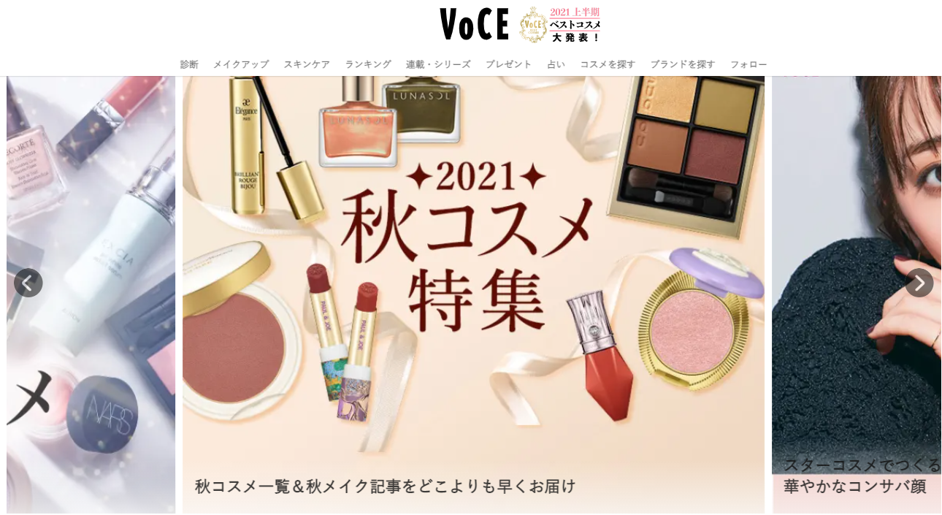
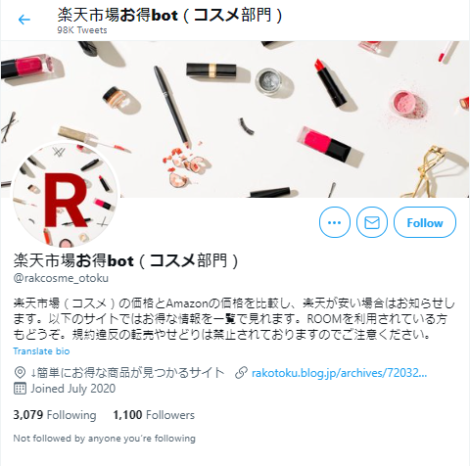
Which authors mentioned the most?
In 2020, there are total 1,026 authors mentioned the product.
Top 6 authors in 2020:
スキンケアおすすめ情報 (29)
I-Voce(25)
anonymous(19)
楽天市場お得bot（コスメ部門）(16)
@cosme公式（アットコスメ）(12)
＠ｃｏｓｍｅ（アットコスメ）(9)
*@cosme公式（アットコスメ）and ＠ｃｏｓｍｅ（アットコスメ）is the same company, just different platform used.

Slide 11
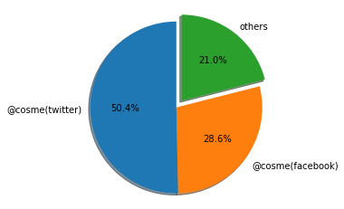
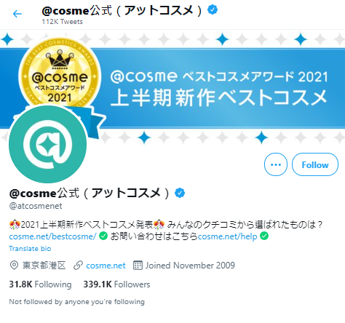
Need to pay attention to ‘Cosme’, why?
Among these 1,026 authors, ‘Cosme’ is the most special and important one.
Cosme got the most followers among those 1,026 authors: @cosme公式（twitter） got 3806287 followers and ＠ｃｏｓｍｅ（facebook）got 2162094 followers. It’s nearly 80% of the total!
Followers percentage:

Slide 12
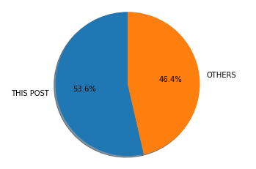
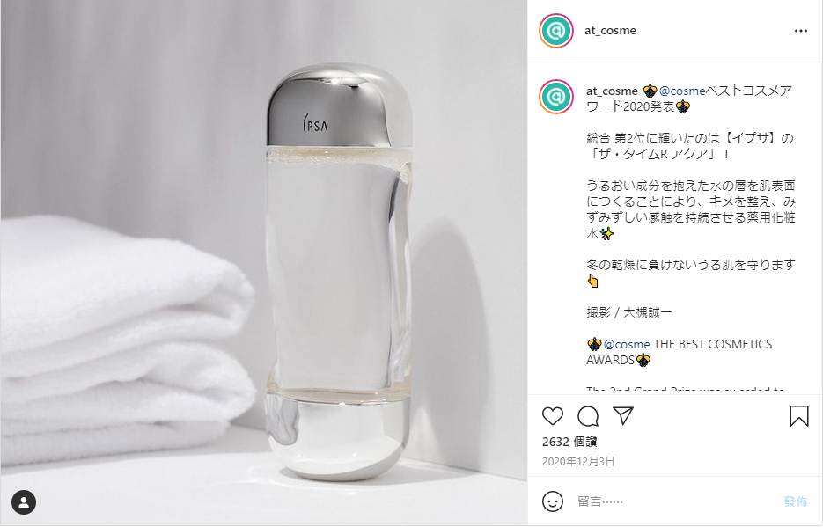
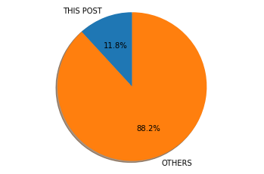
Moreover...
The highest like & Impact Value post came from a Cosme post!
This instagram image post got total 2636 likes(53.6%) & 2646 Impact Value (11.8%).
Like percentage:
Impact Value percentage:
SOURCE: https://www.instagram.com/p/CIUt6_1nA2Q/

Slide 13
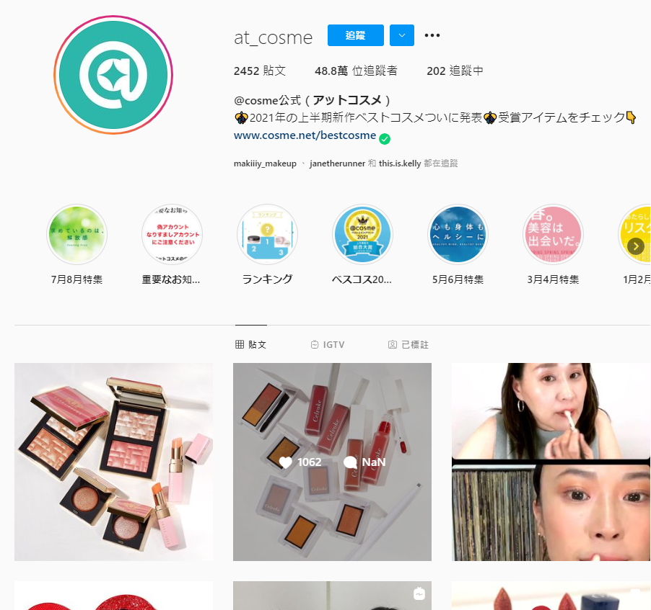
What is Cosme?
Cosme is a beauty product experience and information platform established by istyle Inc. in Japan in 1999.
In the past 20 years, cosme has quickly become the most popular, credible and authoritative opinion platform in Japan.
Cosme will pick the best 10 products every year. A lot of Asian girls pay a lot of tension of Cosme’s opinions.

Slide 14
Part 4:
Which keywords bring the most significant feedback?

Slide 15
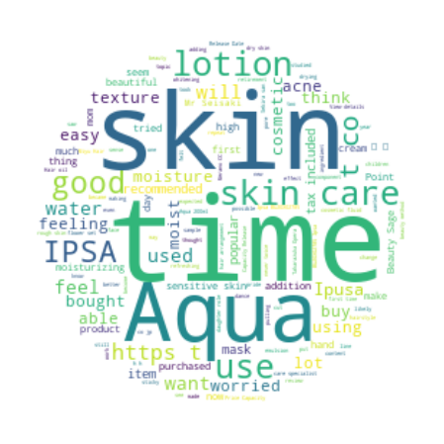
Most used words
‘skin’,’time’,’Aqua’,’lotion’, are the most popular used words.
When the authors talked about the product, some descriptive words like ‘moisture’, ‘moist’, ‘moisturizing’, ‘good’, ‘recommended’, ‘popular’, ‘beautiful’ etc., also have been used a lot.

Slide 16
Top post keyword used
As you can see, the feed of the highest Like & Impact Value also got some popular keywords: ‘moisture’, ‘lotion’, ‘skin’, etc.
Feed word: THE BEST COSMETICS AWARDS🎊The 2nd Grand Prize was awarded to IPSA's "The Time R Aqua"!By creating a layer of moisture over the skin, this lotion balances the skin and retains moisture✨It will support dry skin during the winter👆ipsa_jp#イプサ #ザタイムRアクア #ベストコスメ2020 #アットコスメベスコス #美容 #コスメ #プチプラコスメ #化粧品 #コスメ部 #コスメ好きさんと繋がりたい #ipsa #beauty #makeup #cosmetics #ilovemakeup #beautynews #atcosme

Slide 17
Part 5:
Any other factor(s) may affect the result?

Slide 18
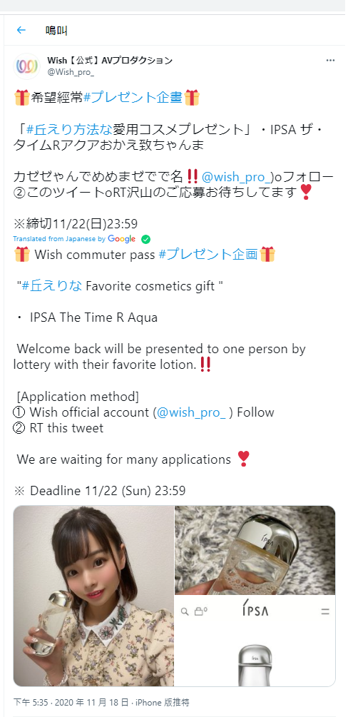
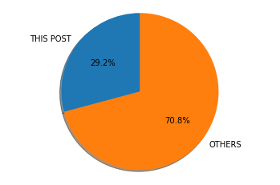
Giveaway post got the highest share
In 2020, the post from Wish【公式】AVプロダクション got the highest share.
This post is a giveaway twitter post. It asked people to share the post for applying the giveaway game.
Share number: 131 (29.2% of total share)

Slide 19
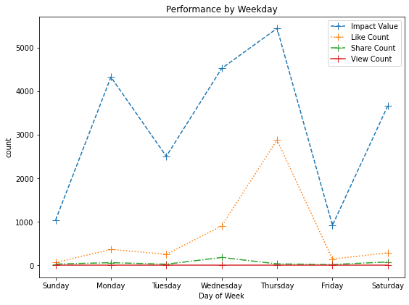
Did post day affect the performance?
From July 2020 to Dec 2020, the performance had a huge drop on every Sunday and Friday. We can believe that people got to enjoy their holiday and spent less time on social media.
Weekday post can bring a better performance.

Slide 20
Conclusion
Instagram brings the most significant result
Image post brings the best result
‘Cosme’ is the most influential platform
Giveaway post can bring higher share numbers
Publish on weekday is much better than weekend

